Slide 1
Mango Website Overview
Website features

Slide 2


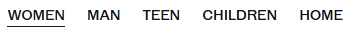
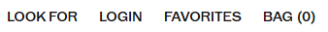
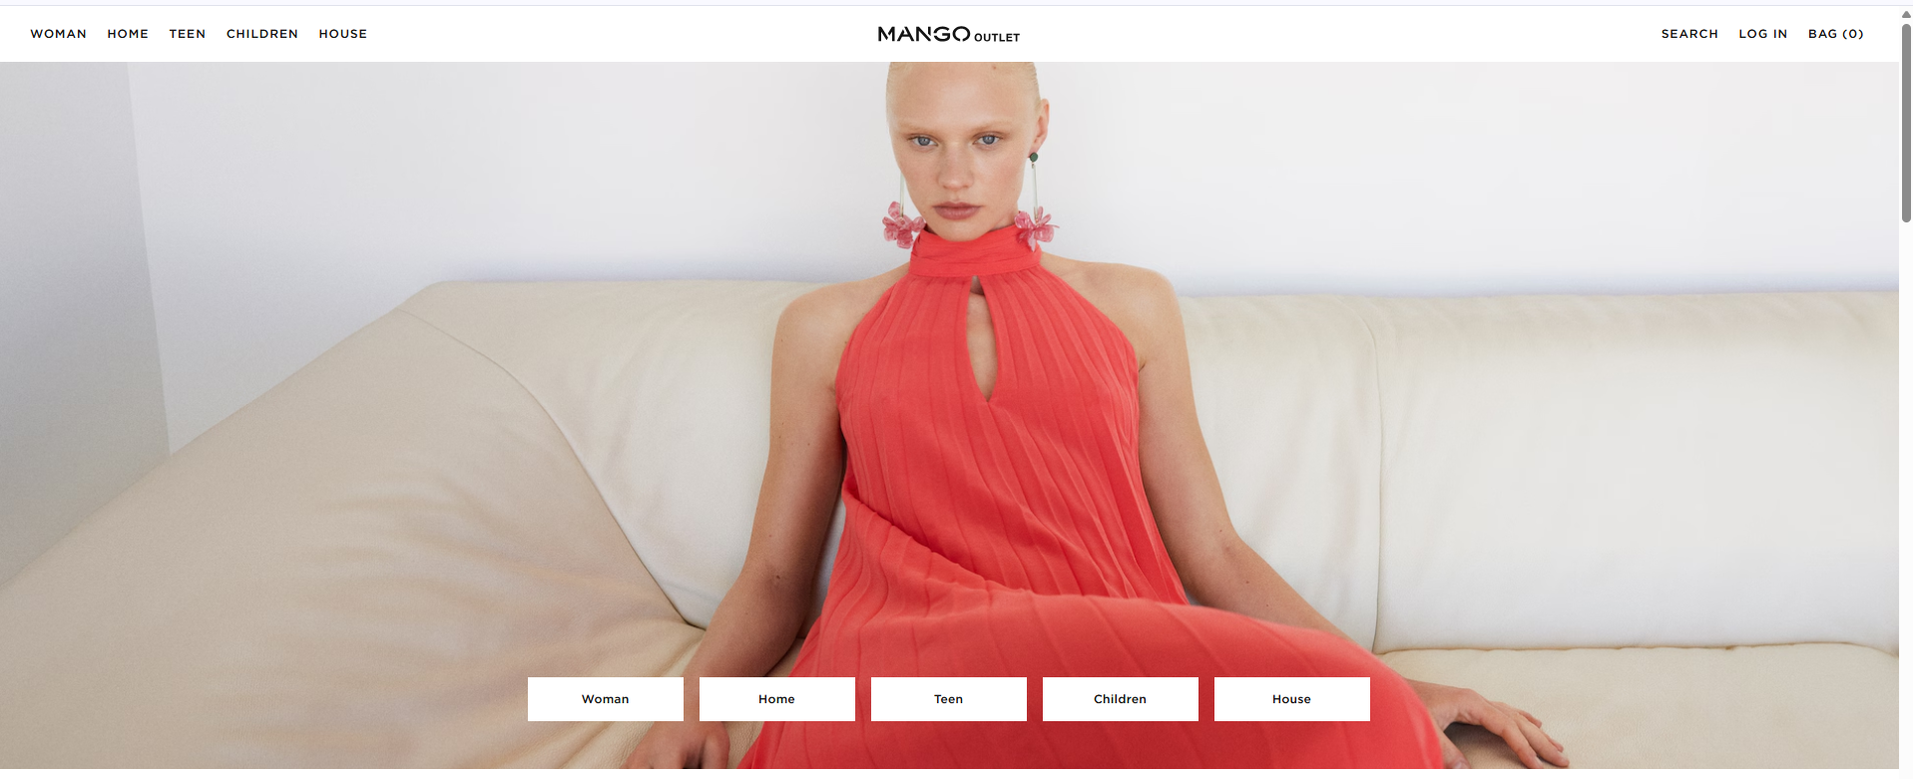

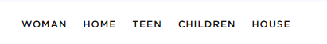
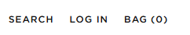

Slide 3
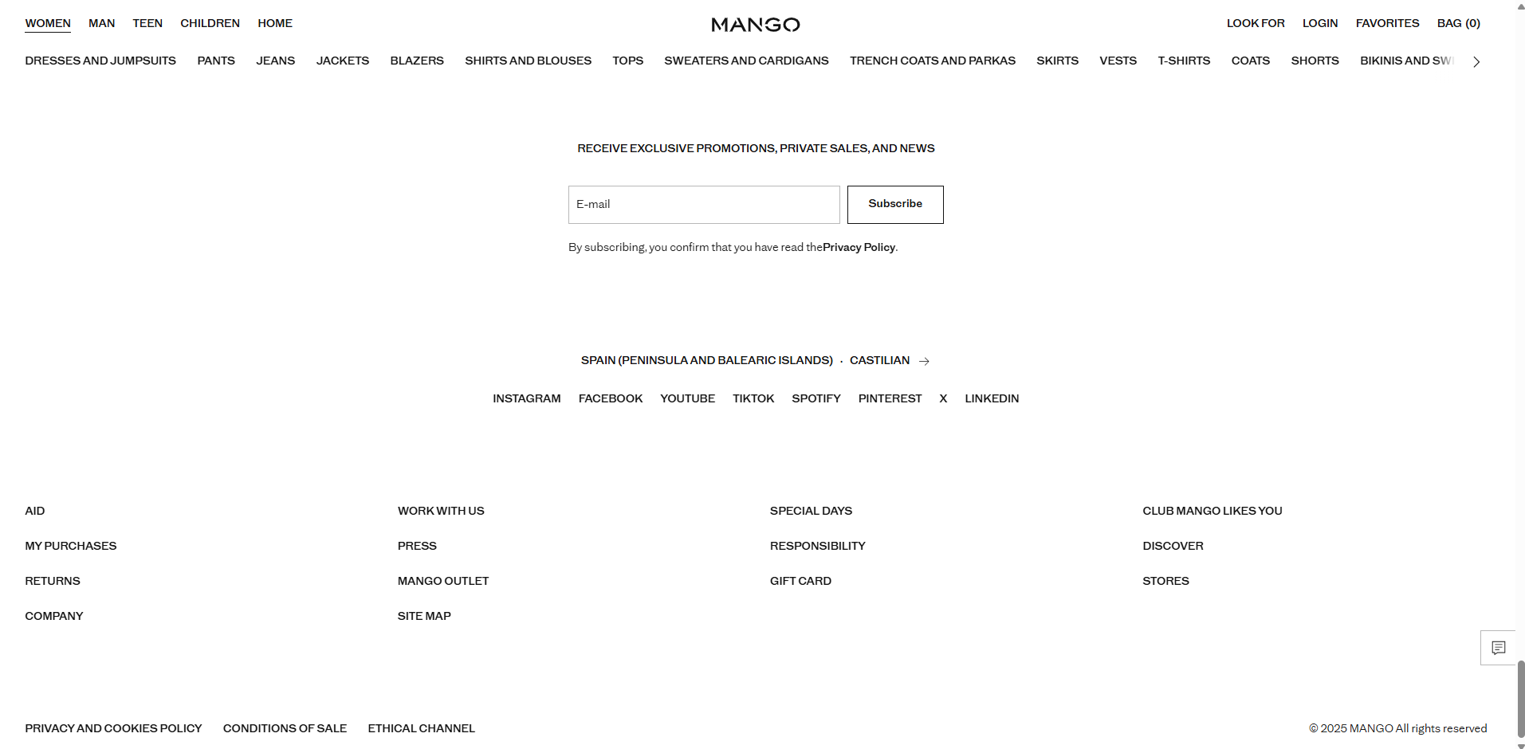
Aid : Frequently asked Questions, categories that will help you assist customers
Mango Loyalty Club info
Return , Exchange and refund policies
Store info: working hours ,Nearby stores , Address
Company’s policies

Slide 4
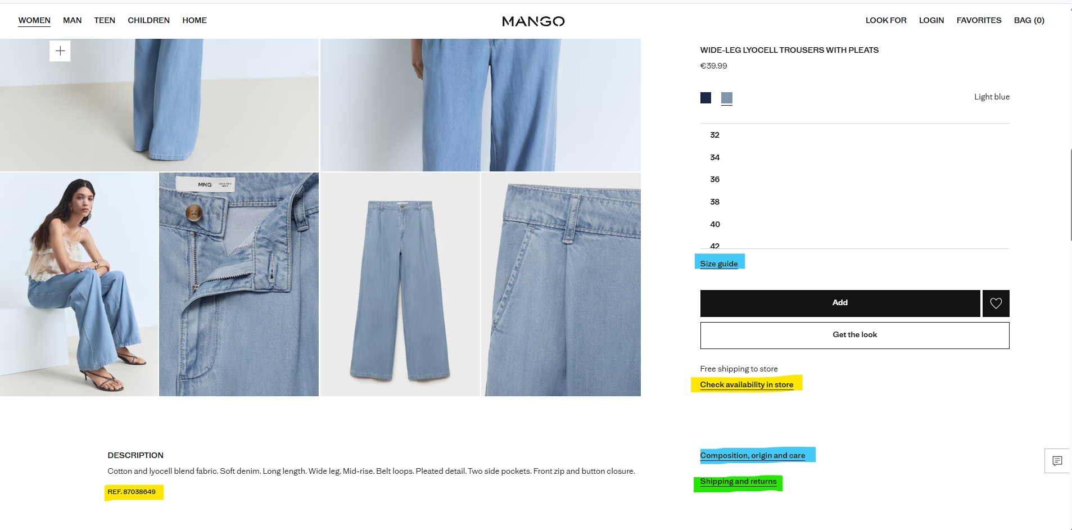

Slide 5
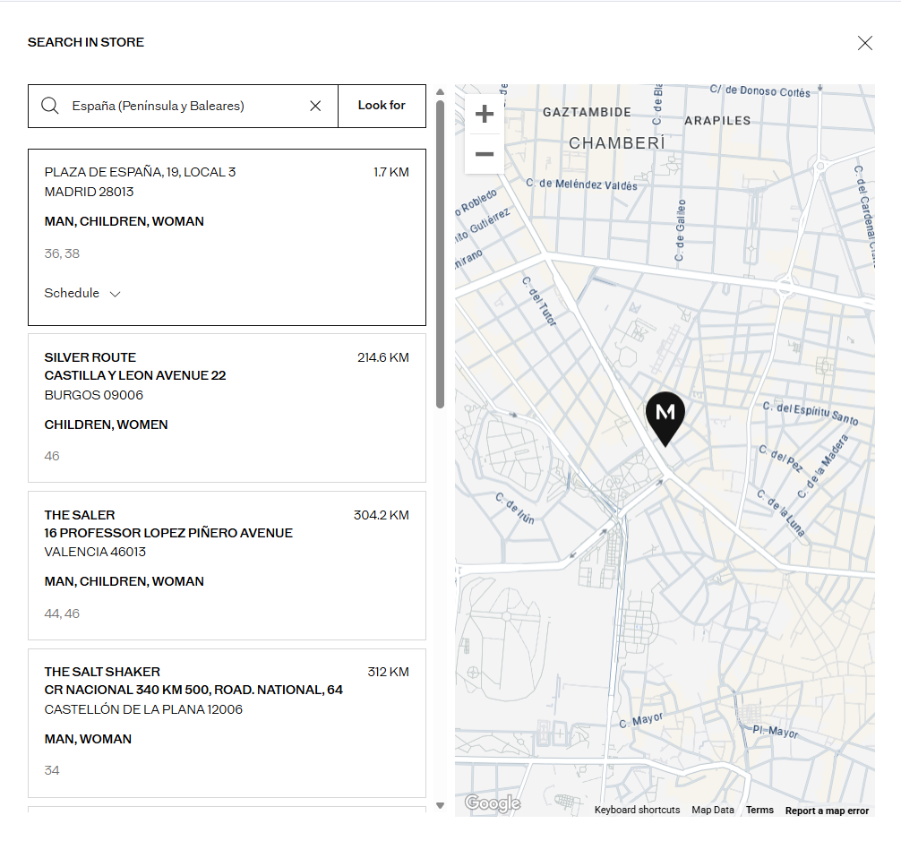
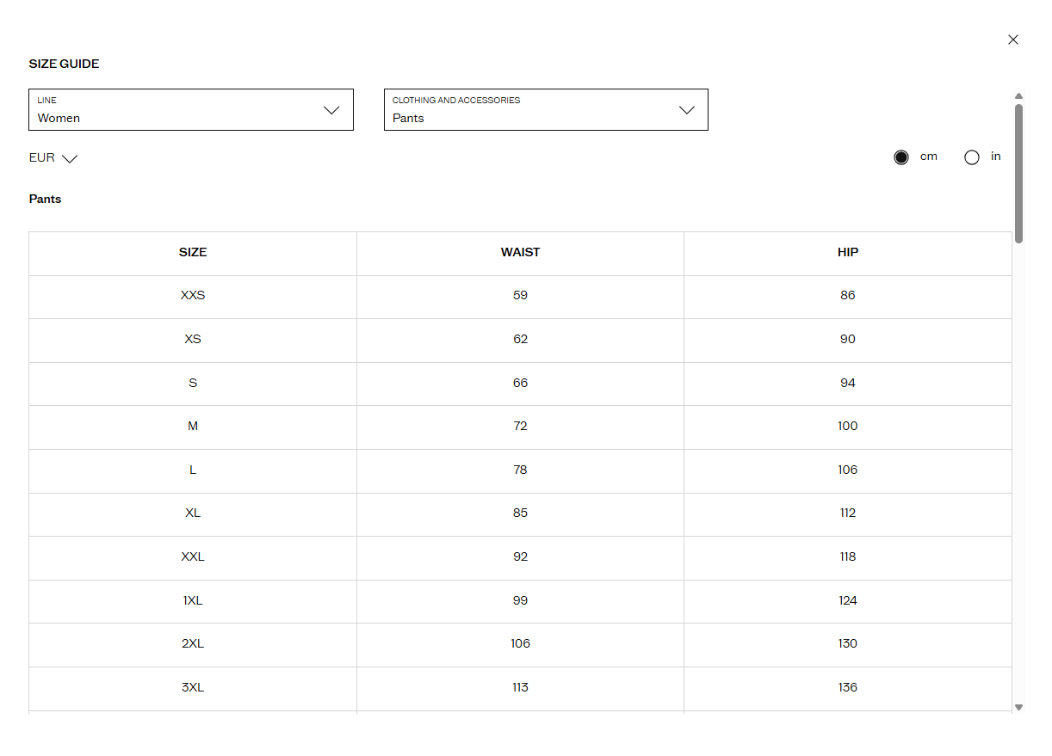
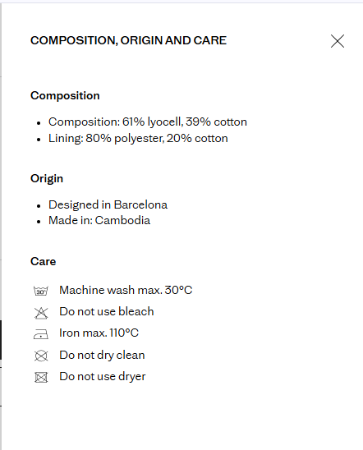

Slide 6
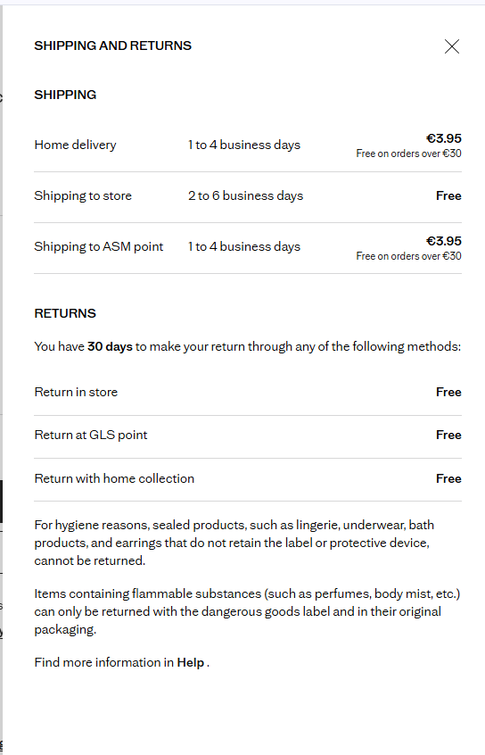
Shipping and returns for the item
Shipping methods + costs
Return period + cost
More information in help section

Slide 7
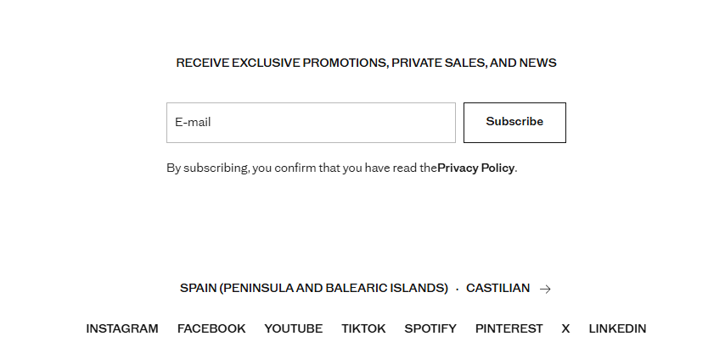
Newsletter subscription
Even without having an account
How to change from Country to another

